Slide 1

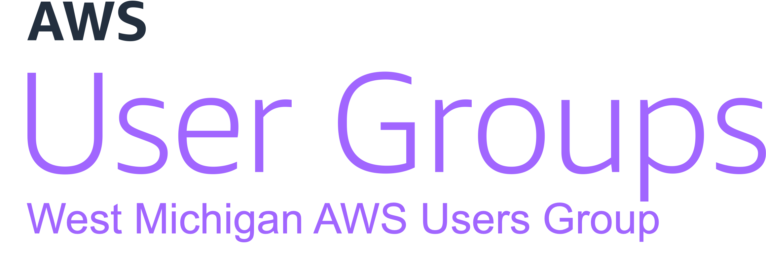

Automating Pull Requests with
CDK and Bedrock
March 2024

Slide 2



Introductions
Trent Nielsen
Justin Wheeler
wheeleruniverse
Enterprise Architect @ PXG
Cloud Consultant
Husband and Father
AWS User Group Leader
Senior Software Developer @ Bravo LT
12x AWS Certified
AWS Community Builder
AWS User Group Leader
Notes:
Use the abundance of AWS on this slide as a transition point

Slide 3
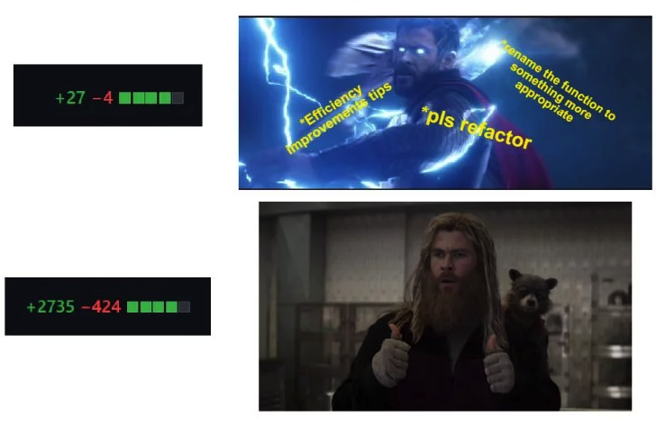

Slide 4
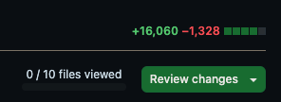
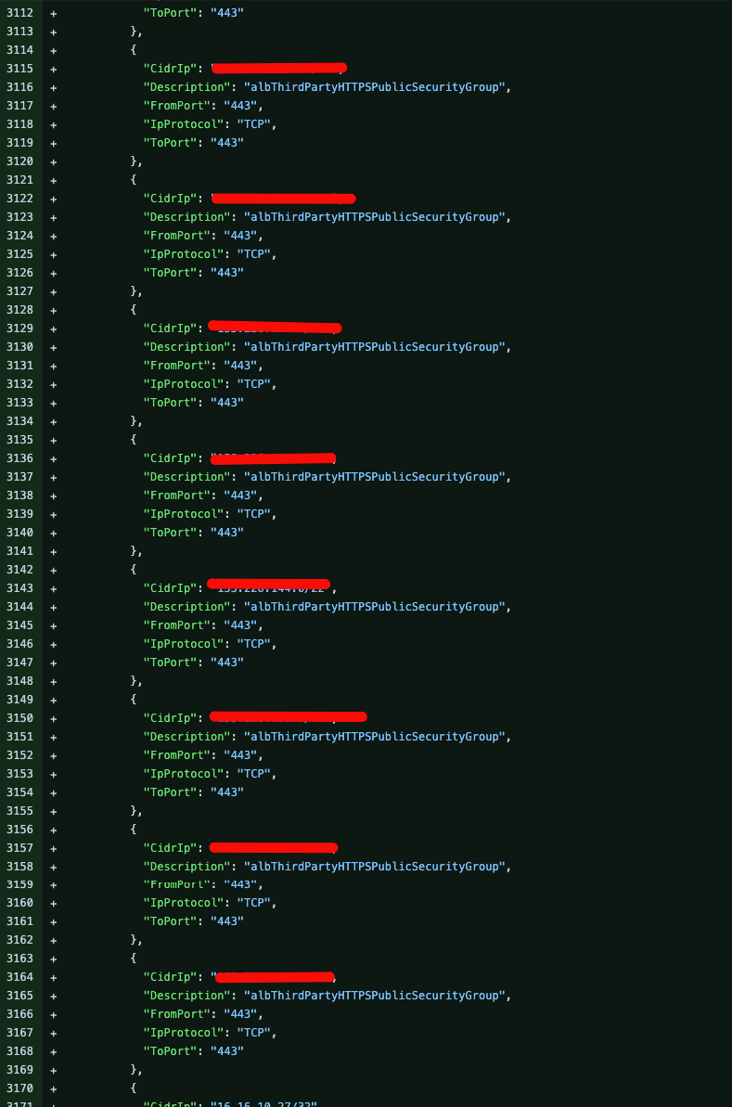
Look Familiar?

Slide 5
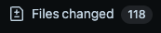
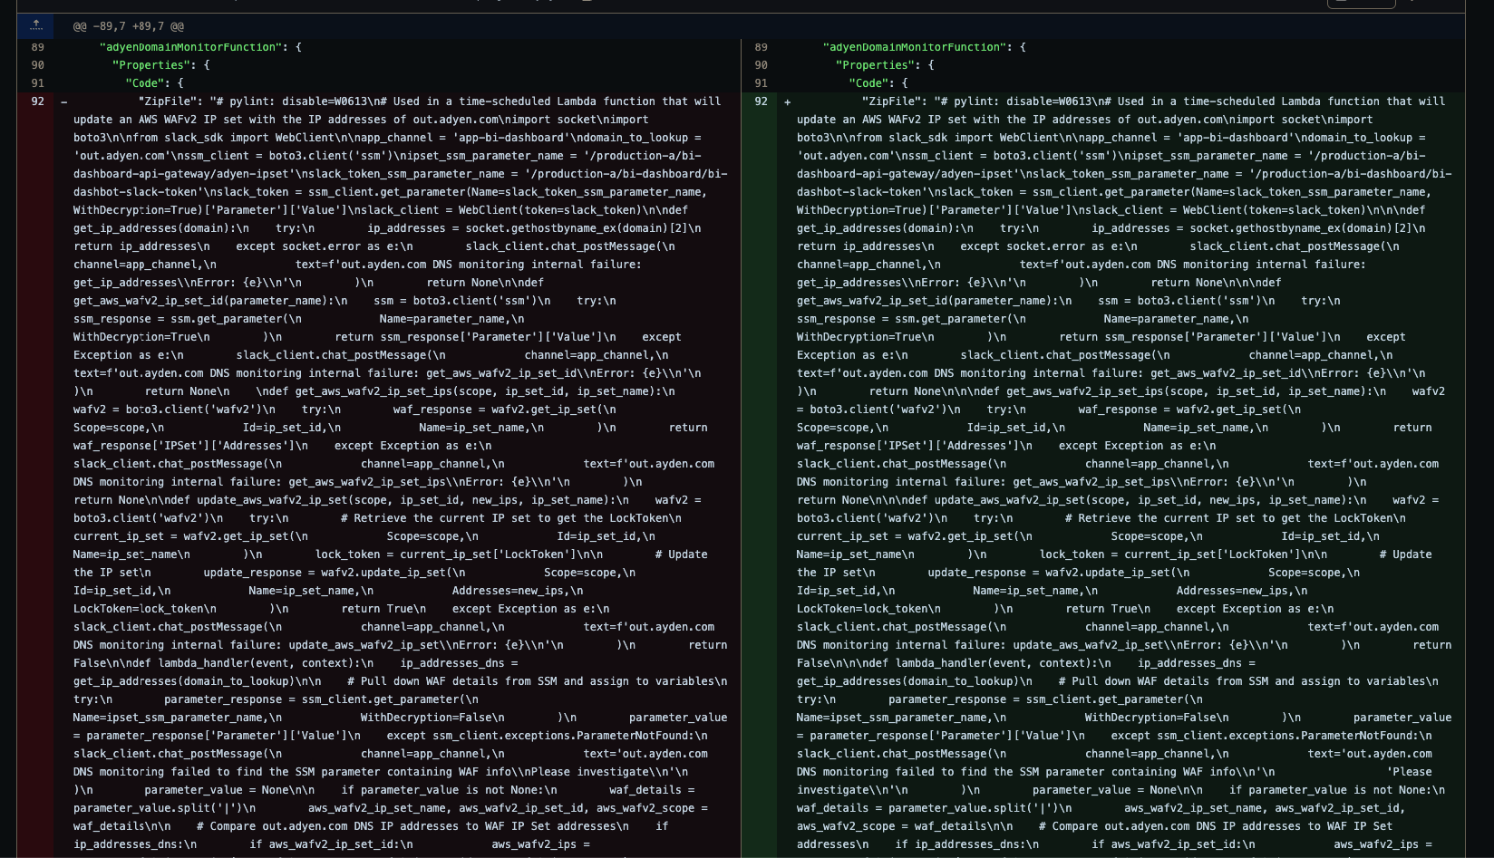
Look Familiar?

Slide 6
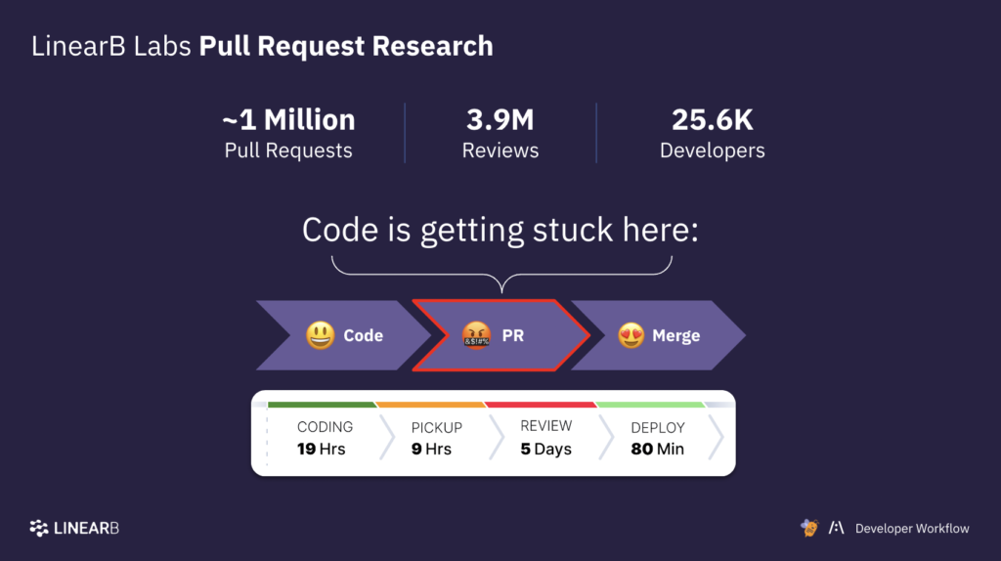
Notes:
pull requests are the biggest bottleneck in software development
large pull requests often don’t get the attention they need, which increases bugs
giving feedback can be repetitive, tedious, and time consuming
certain feedback can harm team morale e.g. whitespace, code formatting issues

Slide 7
PR Problems
Time-consuming, especially for routine changes
Unintended changes can be missed in large PRs
Automatically summarize changes
Automatically nitpick for style/formatting issues
Notes:
Can we drop this in favor of a more graphical slide that we talk to without reading?

Slide 8

Amazon Web Services
W
A
S
The most comprehensive cloud platform
With 200+ fully featured services
Purpose-built offerings
Creates infrastructure with API calls
Supports 100% automation
Functionality that would be hard to replicate
Security at every layer

Slide 9
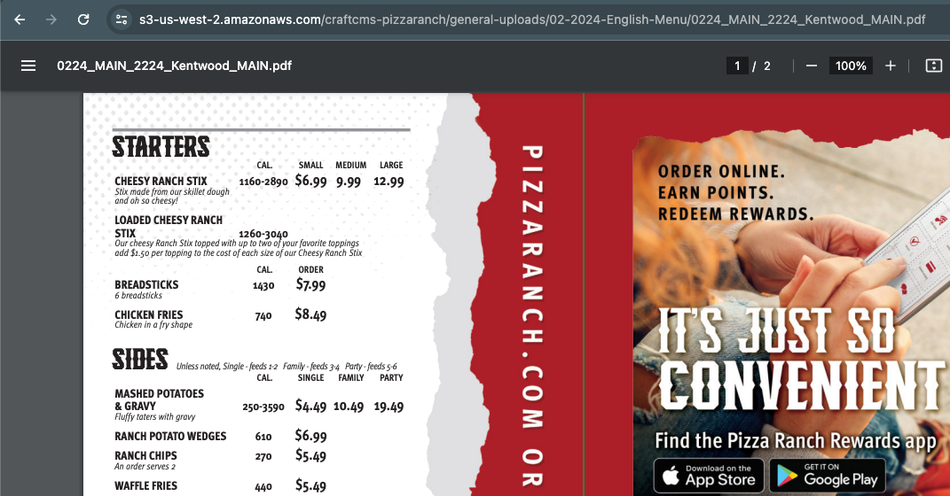
AWS in the Wild
Notes:
Pizza Ranch

Slide 10
AWS in the Wild
Notes:
Pizza Ranch

Slide 11




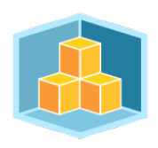


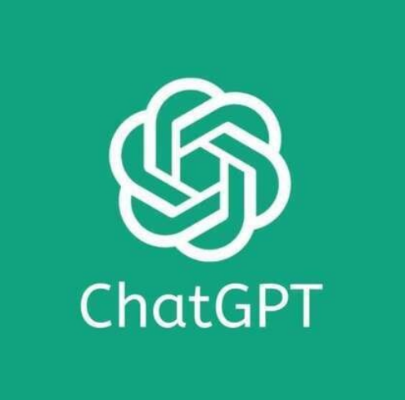
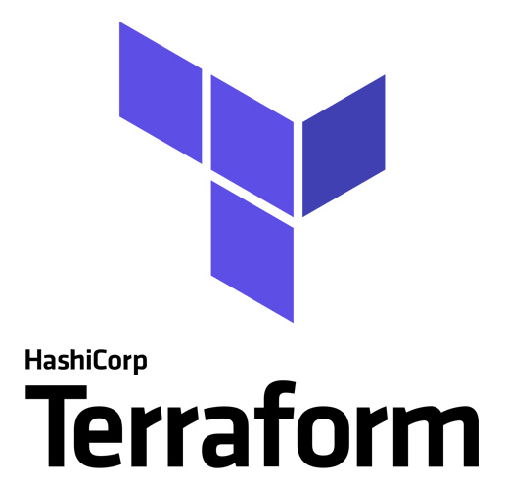

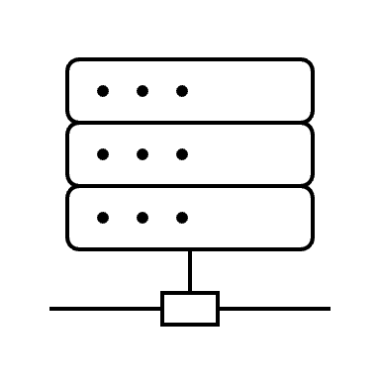
Key Services
Bedrock
Lambda
API Gateway
CloudFormation
CDK
Notes:
TODO: add speaker notes for the services

Slide 12

Solution
AI
Compute
API
Infrastructure
Automation

Slide 13
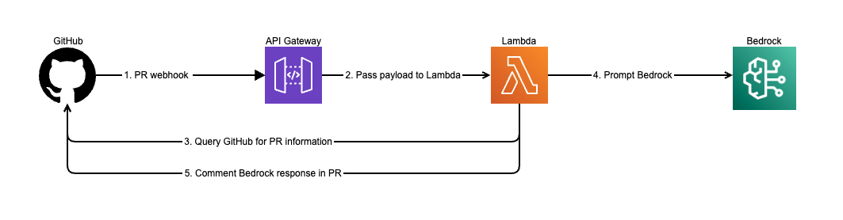
Architecture

Slide 14
API Gateway
Deep Dive

Slide 15
Why API Gateway?
Deployment
Authentication Options
Custom DNS
Validation
Transformation
… and more!
Notes:
Deployment: Blue/Green, Canary, Mock
Authentication Options: Custom API Keys, Identity Providers through Cognito, Custom Authorizers through Lambda
Validation: Request/Response
Transformation: Request/Response
More: Caching, Logging, Rate Limiting, Throttling

Slide 16
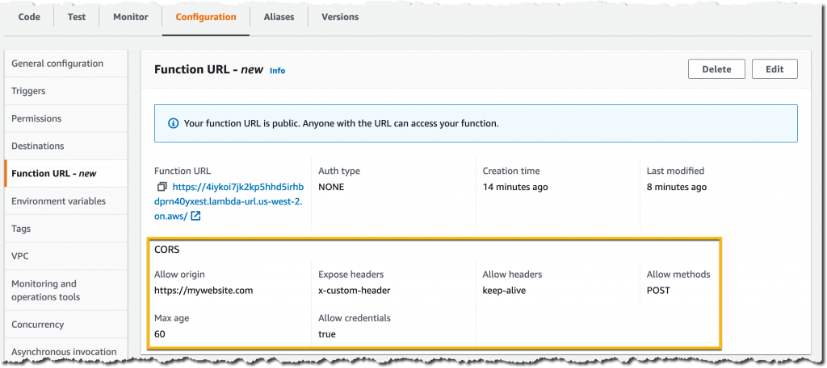
Lambda Function URL (Alternative)
Notes:
https://aws.amazon.com/blogs/aws/announcing-aws-lambda-function-urls-built-in-https-endpoints-for-single-function-microservices/

Slide 17
CDK
Deep Dive

Slide 18
Why CDK?
Control
Organization
Reusability
Familiarity
Deployment
Notes:
Control: if, for, while
Organization: code management
Reusability: shared code and libs
Familiarity: same programming languages, tools, and workflows – no Domain Specific Languages (DSL) like Terraform HashiCorp Configuration Language (HCL)

Slide 19
App Logging
- API Gateway can be enabled for access logs
- Enabled for Lambda execution logs
- Bedrock prompts are logged

Slide 20
Bedrock
Claude Model access – must be requested in the console, no provisioned resources required.
Proposed solution used Claude 2.1

Slide 21
GitHub

Slide 22

More than just a code repo
Actions
Webhooks
Secrets

Slide 23
Actions Automation
Build Environment
CDK Synth
CDK Deploy
Notes:
Build Environment:
Install AWS-CDK and Python
Configure AWS Credentials
Build Assets
Layer
Lambda

Slide 24
Webhooks
Configured Per Repo
Event Triggers
Enabled for PrBot

Slide 25
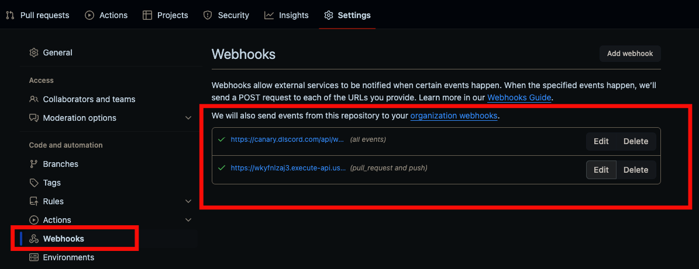

Slide 26
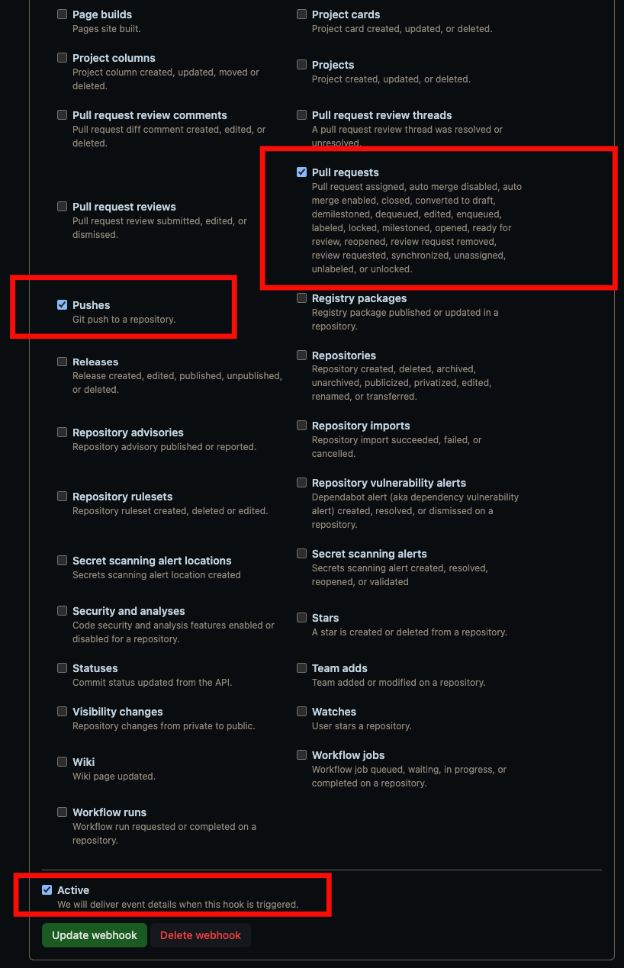
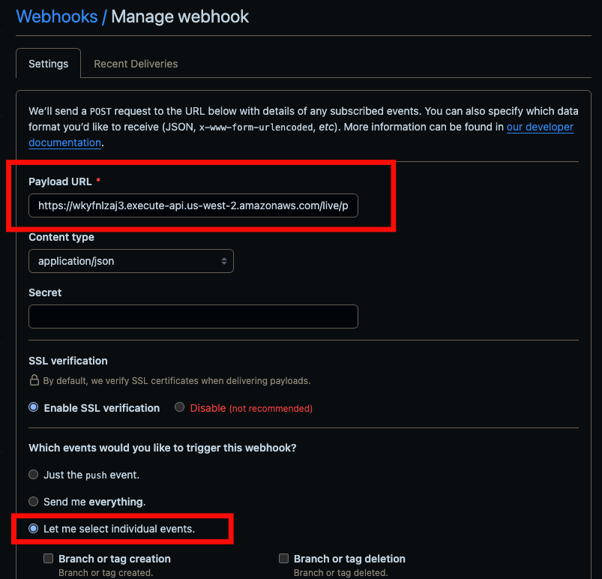

Slide 27

Secrets
Deploy user
Github Token

Slide 28
CI Secrets
Service Account Keys
Configured in GitHub
Notes:
Service Account Keys: provides deploy keys for Actions

Slide 29
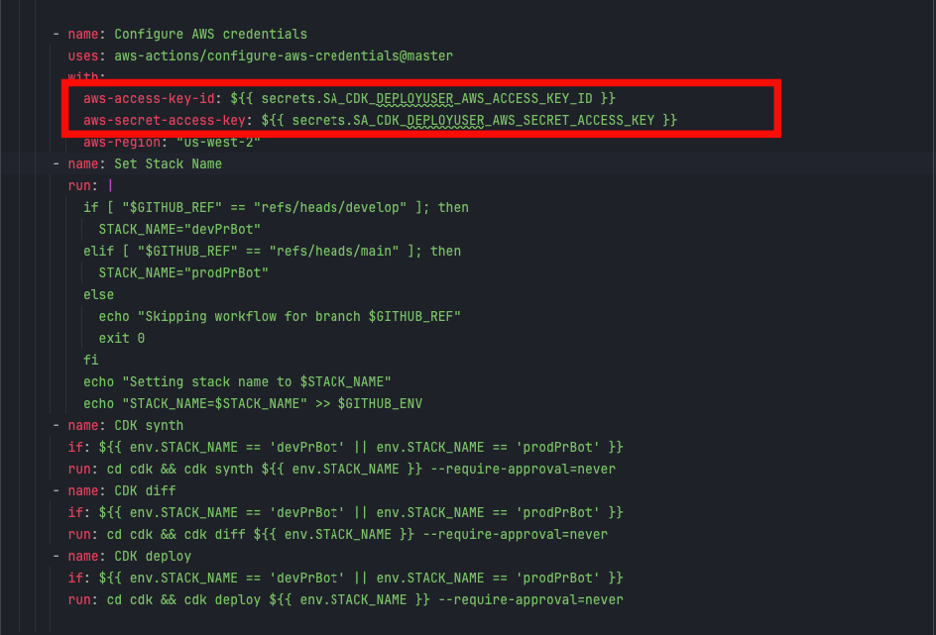
CI Secrets

Slide 30
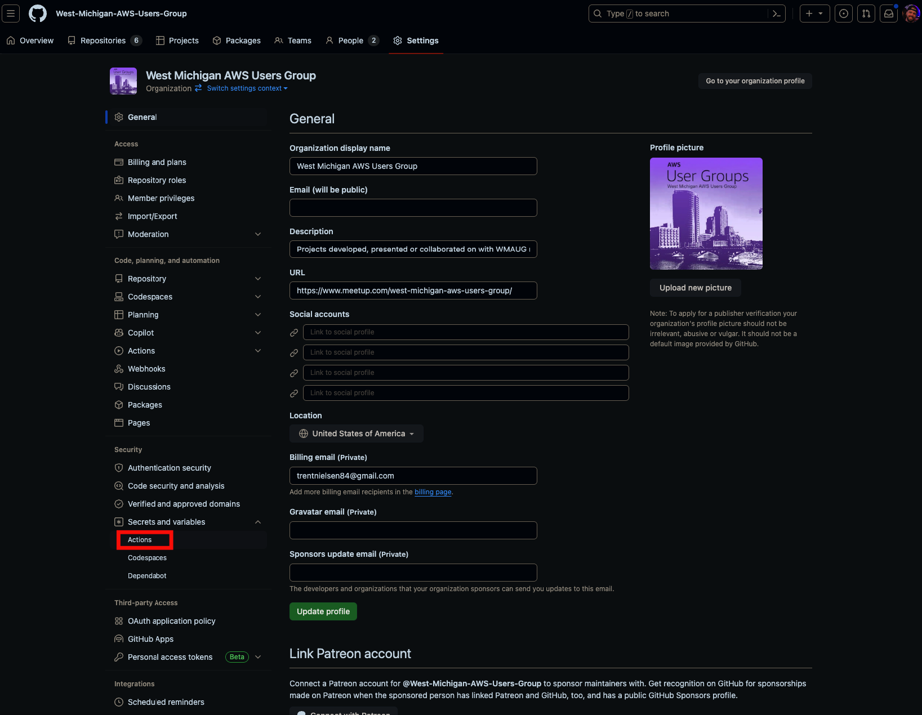

Slide 32
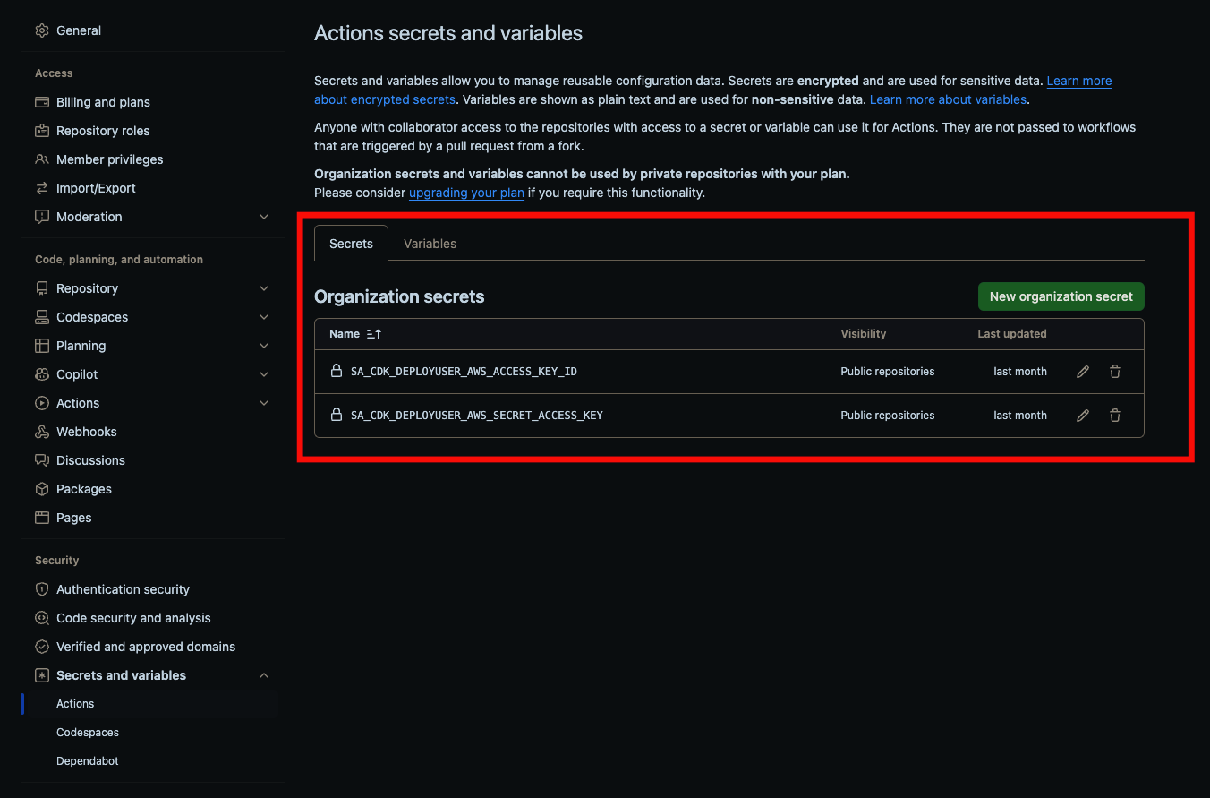
Secrets

Slide 33
App Secrets
AWS Secrets
Code Reference

Slide 34
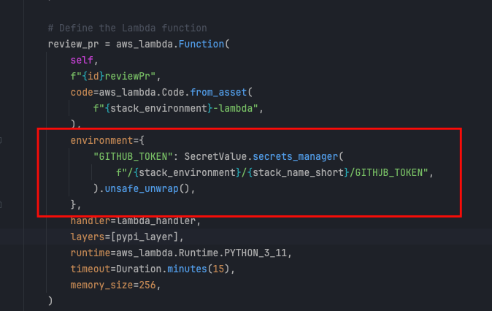
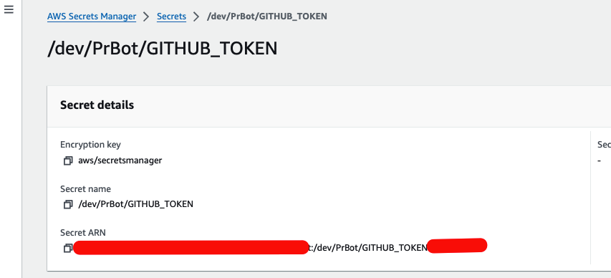
App Secrets

Slide 35
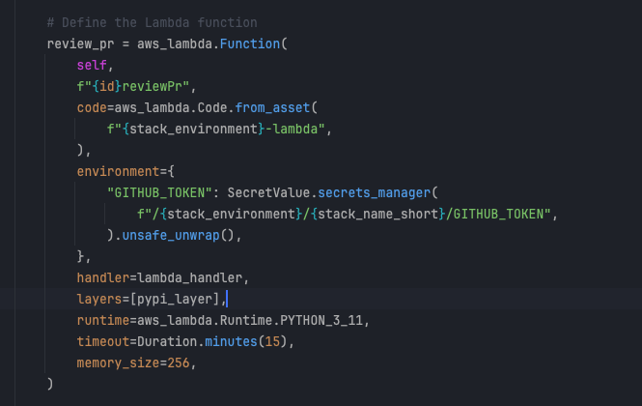
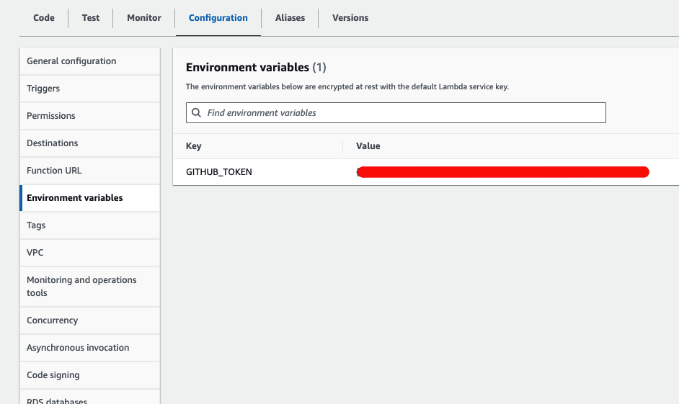
Secrets (Unsafely Unwrapped)

Slide 36
Actions Config
Review

Slide 37

Lambda + Bedrock Code Review

Slide 38
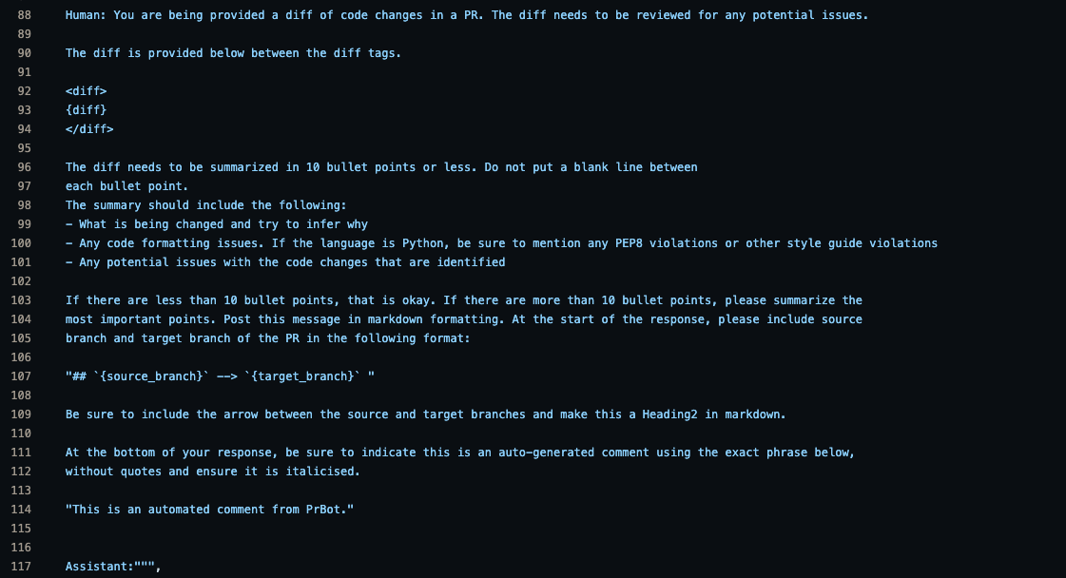
Prompt

Slide 39
Examples

Slide 40
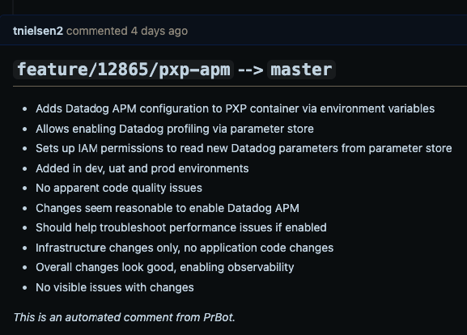
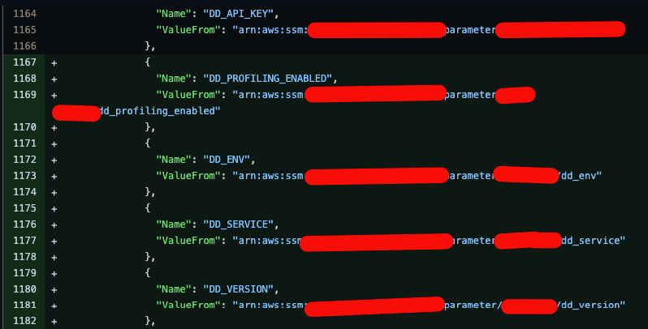
New Environment Variables

Slide 41
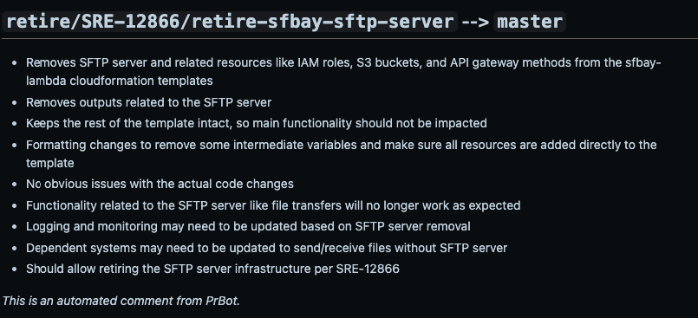
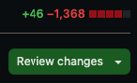
Stack Retirement

Slide 42
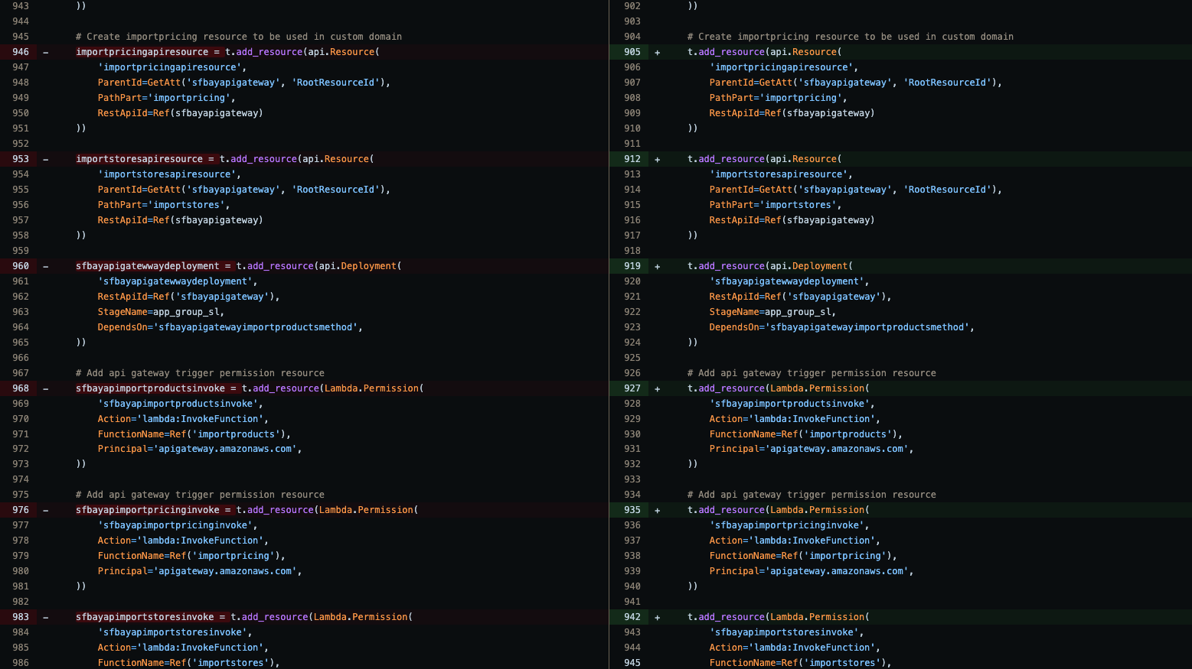
Stack Retirement (Continued)

Slide 43
Cost

Slide 44
Freebies
2,000 mins/month
GitHub Actions
CDK
1,000,000 requests/month
400,000 GB-secs of compute/month
Lambda
CloudFormation
Notes:
GitHub Actions:
https://github.com/pricing/calculator
https://docs.github.com/en/billing/managing-billing-for-github-actions/about-billing-for-github-actions
AWS:
Free Tier: https://aws.amazon.com/free/

Slide 45
Billed Services
$1.00/1,000,000 requests
$0.008/1,000 input tokens
$0.024/1,000 output tokens
API Gateway (http)
Bedrock
(Claude 2.1)
$0.20/1,000,000 requests
$0.0000166667/GB-sec of compute
Lambda
(x86)
US East (N. Virginia) as of 2024-03-07
Notes:
AWS:
Lambda
Bedrock

Slide 46
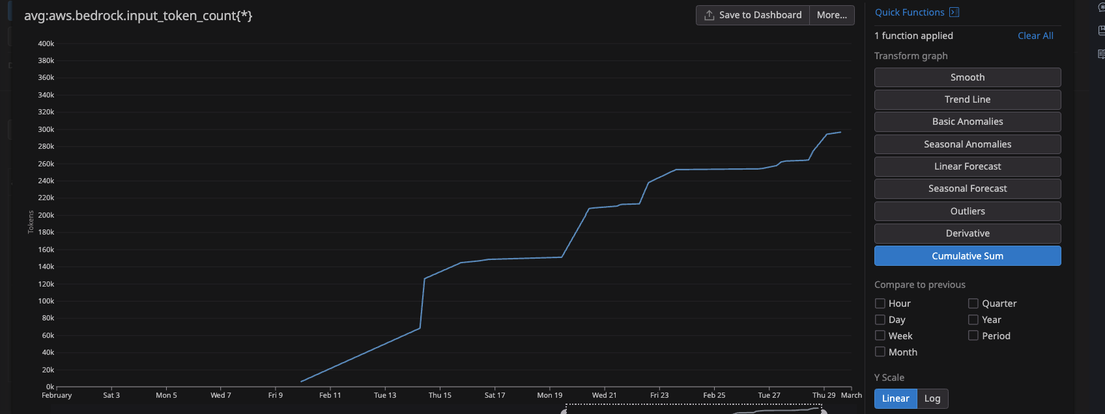
Usage

Slide 47
Usage

Slide 48
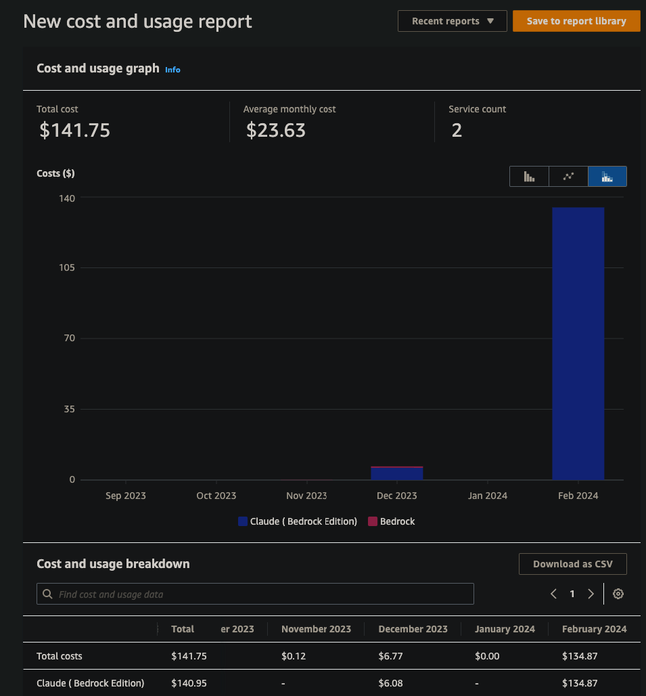
The Bottom Line

Slide 50
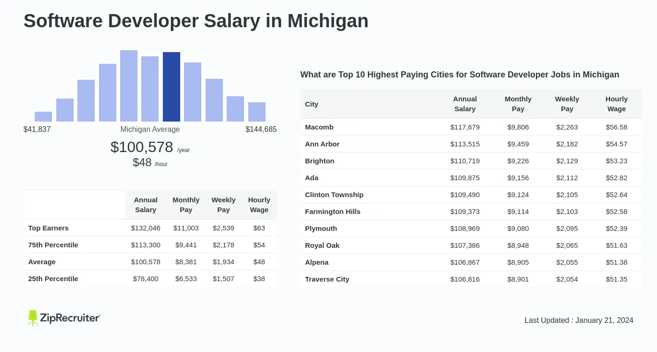
Total Cost of Ownership (TCO)

Slide 51
Total Cost of Ownership (TCO)
1 hour/day
5 hours/week
5/40 = 0.125
$78,400/year
$78,400 * 0.125 = $9,800/year

Slide 52
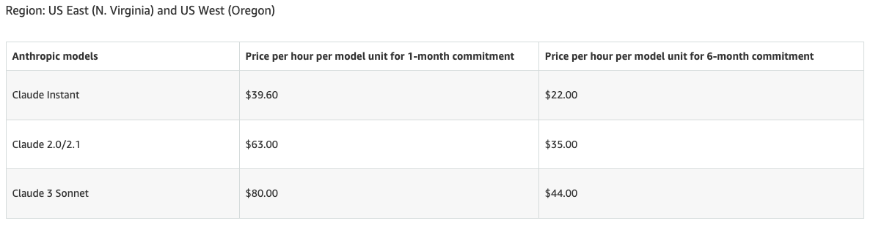
Cost Optimization
Fail Fast
Skip Irrelevant
File Filter
Manual Trigger (I am ready button)
Provisioned Throughput
Notes:
Fail Fast: prettier, lint, tests, sonar, etc.
Skip Irrelevant: 1-line changes, blacklist/whitelist, draft, and WIP
File Filter: blacklist/whitelist file extensions

Slide 53
Cost Optimization
Provisioned Throughput
Notes:
Fail Fast: prettier, lint, tests, sonar, etc.
Skip Irrelevant: 1-line changes, blacklist/whitelist, draft, and WIP
File Filter: blacklist/whitelist file extensions

Slide 54
Title Slide
Improvements
AWS User Groups
54

Slide 55
Layer
Layer build process and version pinning
Tests
Implement CDK Tests
Permissions
Migrate to Service Account
Triggers
On demand w/ label usage
Update
Fetch Secrets instead of Environment Variables
Automation
Auto-tagging after Approvals
Notes:
Layer
Unique per environment for future testing
Pin to known good versions to prevent unexpected layer changes
Automation
2x auto-reviewer tagging

Slide 56
User Group Updates
New Organizer
2024 Schedule
User Group AWS Account(s)
AWS Account Credit Raffle

Slide 57

Current
PrBot
Upcoming
Betrayal Buddy
WMAUG Website
WMAUG AWS Account Rollout

Slide 58
Raffle
import random def print_random(values): index = random.randint(0, len(values) - 1) selected = values[index]
print(f”Winner: {selected}")
print_random(["Trent", "Justin", "Darth", "Luke", "Chewy”])

Slide 59

AWS User Groups
59
Notes:
Take Questions

